Slide 1
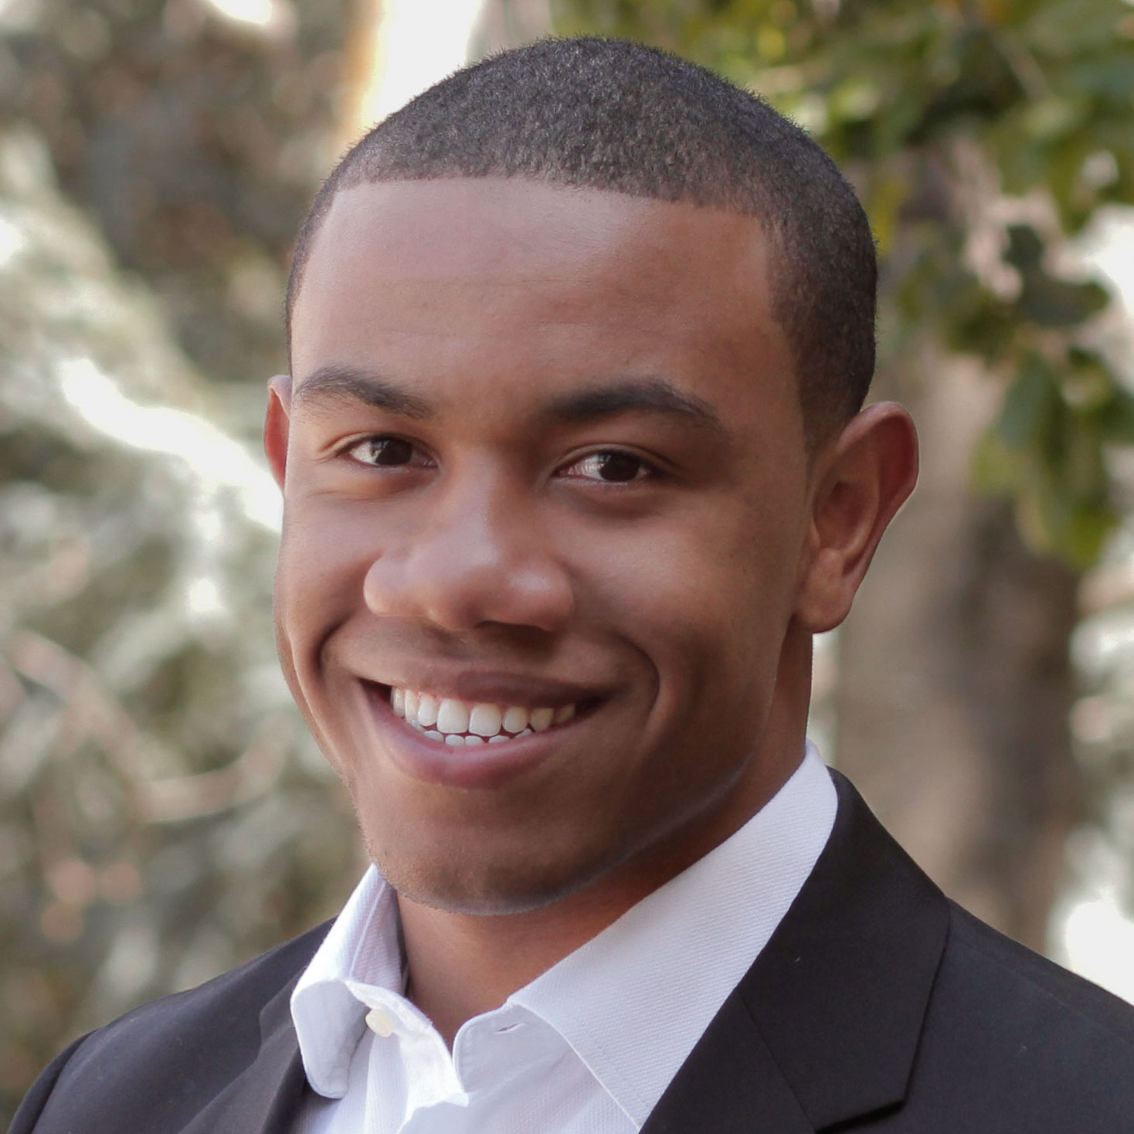
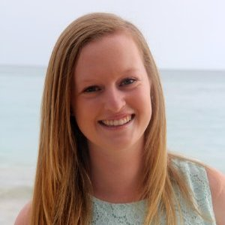
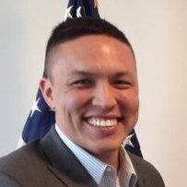
POV and Experience Prototypes
Team: Laura B, Matthew C, Leslie K, Saamon L
Studio: Digital Democracy
Presenter: Matthew C

Slide 2
Problem Domain
Uninformed
Politics

Slide 3
Problem Domain
Uninformed
Politics
One-Sided
News

Slide 4
Initial POV

Slide 5
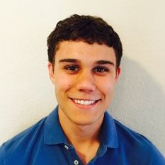
Initial POV
Almost never sees news articles or opinions that he disagrees with
Still considers himself more informed than almost everyone else
Want to help him understand news biases and have easy, balanced way to stay informed
Notes:
We met Bryan Powell, a 22-year old student at the University of Texas. We were amazed to learn that he almost never sees news articles or opinions that he disagrees with, but still considers himself more informed than almost everyone else. It would be game-changing if there were a way for people like Bryan to understand how biased their sources of information are and for them to have an easy, balanced way of staying informed.

Slide 6
Additional Needfinding

Slide 7
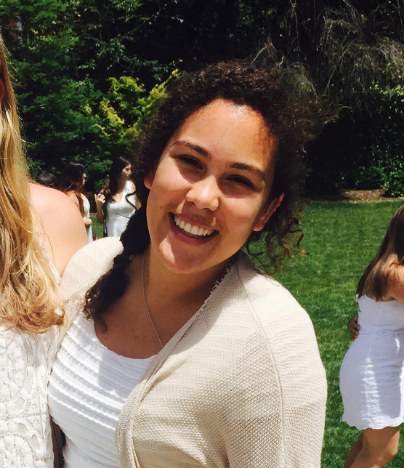
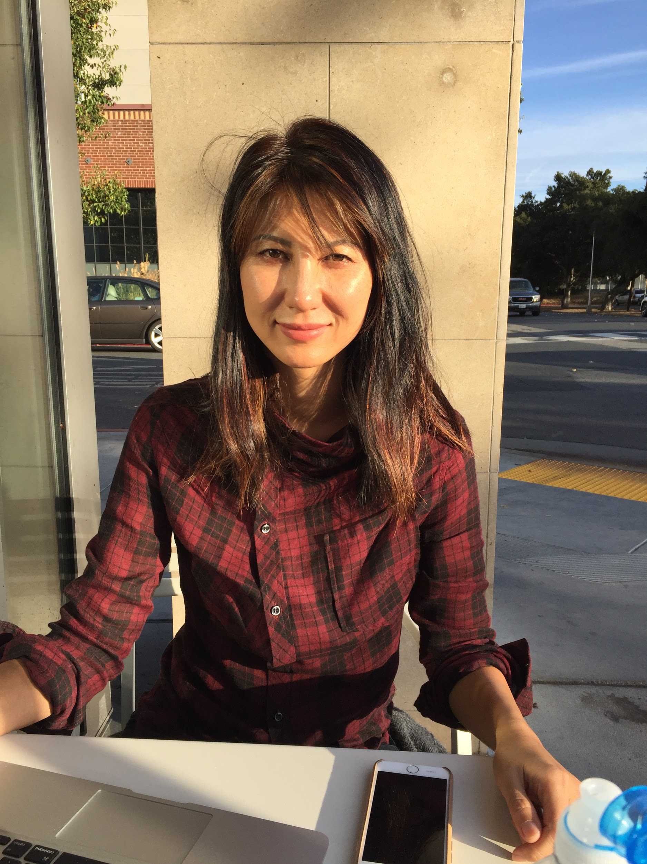
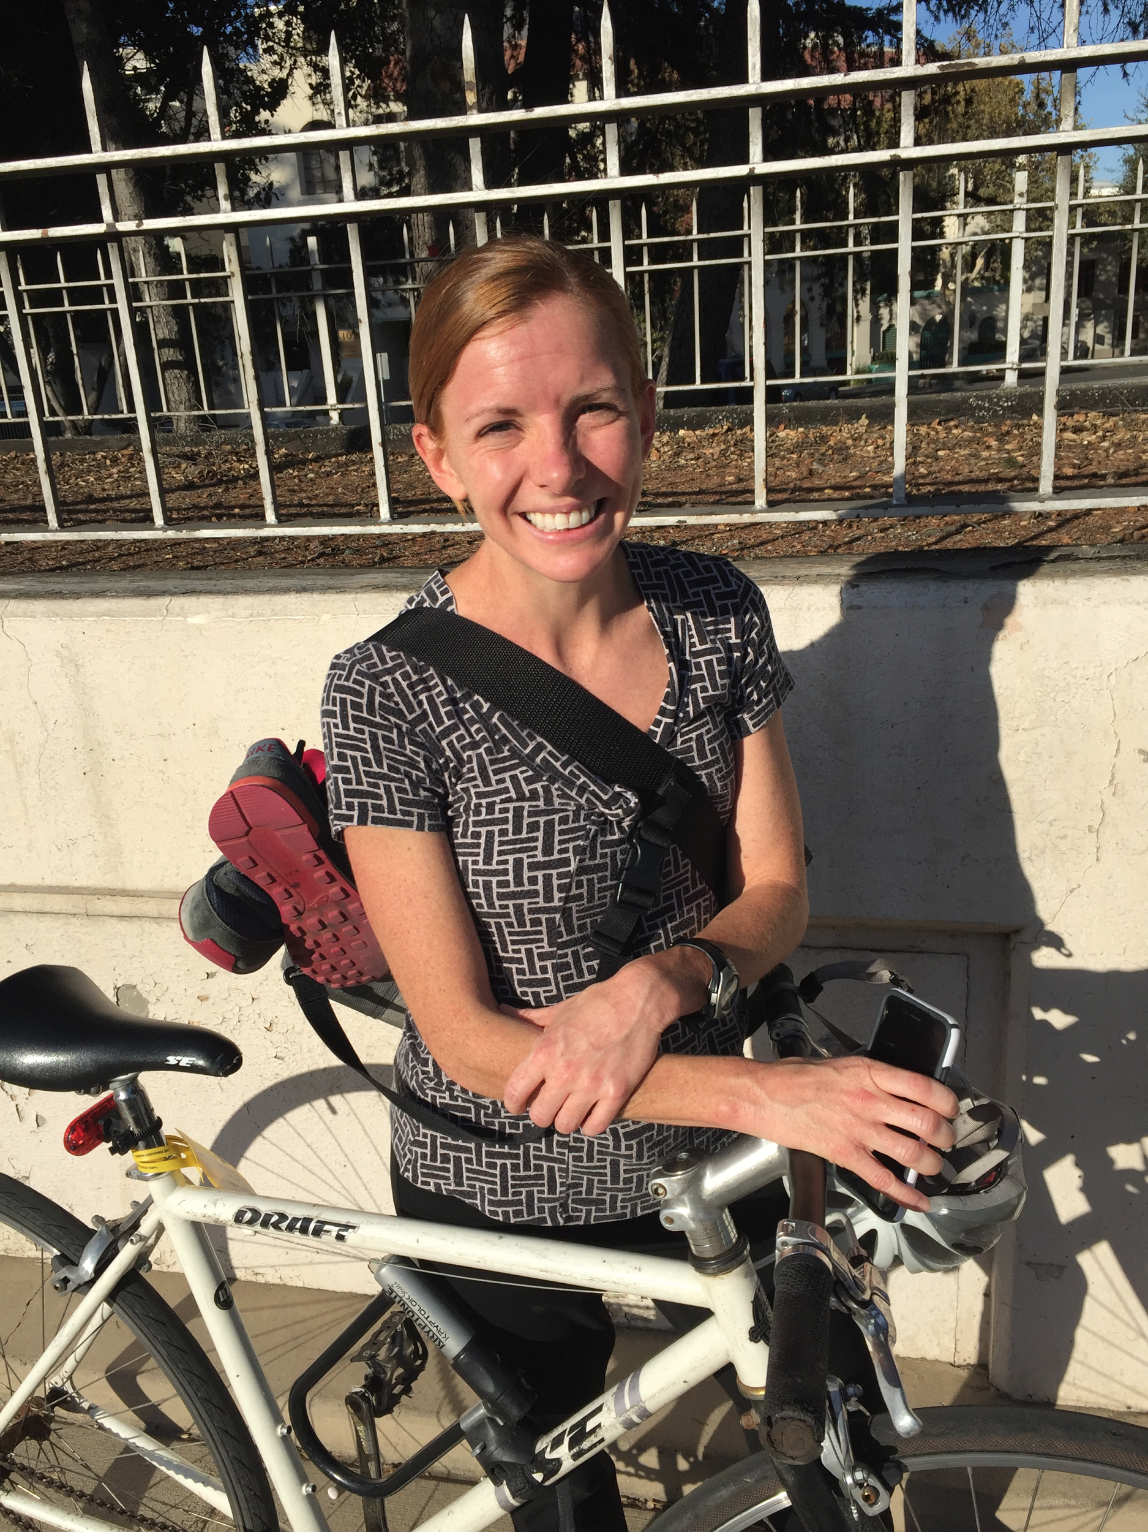

Who we interviewed
Bonnie
Pat
Notes:
Ages: college to teaching college for decades
Interests: From political experts to those who aren’t actually interested in politics (beyond what affects them)
Very wide ranging racial demographics, about equal split of genders
From conservative to liberal
Why chosen: from people on the street to the very informed
Where: NorCal to SoCal (via phone), recruited on and off campus in the general area
WHO: Students, professor, IT support, soldier, social justice warriors and researchers.

Slide 8
POV 1: Taylor
Facebook news feed primarily opposing views
Extreme views made her feel “icky”
Wants to understand how the other side things
Notes:
We talked to Taylor Streaty at Coupa Cafe, a liberal from Nashville, Tennessee. She also grew up in an area with extreme opposing views to that of her own. Taylor’s biggest complaint was that her news feed consisted mainly of people with strong, opposing views from her own. She found these views “icky” and they made her angry and upset. She was, however, interested in learning how people with opposing views understand the world.
We met Taylor Streaty who needs a social news feed that is more well rounded and less one-sided because the majority of her friends from home have extreme views opposite to those of her own. These opposing, extreme views made Taylor upset and angry, and less likely to read the news and understand where the other side was coming from. It would be game changing if Taylor could diversify her news feed and receive a more well-rounded version of the news.

Slide 9
POV 1: Taylor
Facebook news feed primarily opposing views
Extreme views made her feel “icky”
Wants to understand how the other side things
Game-changer: social news feed that is more well-rounded
Notes:
We talked to Taylor Streaty at Coupa Cafe, a liberal from Nashville, Tennessee. She also grew up in an area with extreme opposing views to that of her own. Taylor’s biggest complaint was that her news feed consisted mainly of people with strong, opposing views from her own. She found these views “icky” and they made her angry and upset. She was, however, interested in learning how people with opposing views understand the world.
We met Taylor Streaty who needs a social news feed that is more well rounded and less one-sided because the majority of her friends from home have extreme views opposite to those of her own. These opposing, extreme views made Taylor upset and angry, and less likely to read the news and understand where the other side was coming from. It would be game changing if Taylor could diversify her news feed and receive a more well-rounded version of the news.

Slide 10
POV 2: Maria
Who needed an easier way to learn about down-ballot issues
Because she reports to “not know much” about down-the-ballot issues
Notes:
Consistent questioning across individuals
Pros: aren’t scattered about with our questions and thus able to discern some kind of pattern
Cons: Maybe asking the same questions also reduces new insights (but that is why we asked follow-up questions)
How was the voting experience for you?
How do you decide how to vote on an issue?
How often do you see media that supports/contradicts your own opinion?
Have you ever voted on a referendum? How was that experience different?
What would you want to know about referendums beforehand?
Have you ever taken a quiz about politics that tells you which politicians/ideologies you align with most? Was it accurate/surprising/…?
How do you feel while reading something (political) that you disagree with?

Slide 11
POV 2: Maria
Who needed an easier way to learn about down-ballot issues
Because she reports to “not know much” about down-the-ballot issues
Game-changer: one-stop shop to see the pros/cons of a proposal in an unbiased fashion
Notes:
Consistent questioning across individuals
Pros: aren’t scattered about with our questions and thus able to discern some kind of pattern
Cons: Maybe asking the same questions also reduces new insights (but that is why we asked follow-up questions)
How was the voting experience for you?
How do you decide how to vote on an issue?
How often do you see media that supports/contradicts your own opinion?
Have you ever voted on a referendum? How was that experience different?
What would you want to know about referendums beforehand?
Have you ever taken a quiz about politics that tells you which politicians/ideologies you align with most? Was it accurate/surprising/…?
How do you feel while reading something (political) that you disagree with?

Slide 12
POV 3: Bonnie
Who needed a way of ensuring the news she reads is unbiased
Because she worries that, like her friends, she could be creating her “own reality” with one-sided news
Bonnie
Notes:
Bonnie was attending a lecture series on the election held at Stanford when we asked her to talk about news and politics. She is a teacher who tries her best to keep up with politics, but says she misses the details on occasion. She shared stories about her own experiences voting as well as concerns about some of her friends and their news sources. She told us about how once, after a lot of careful research, she voted for a Republican, despite being “very liberal” and warned us to “not tell her husband” because he’d make fun of her for it. It was interesting to hear about the time she spent looking into issue and candidates that allowed her to make an informed decision and not just vote on party lines. She also expressed concerns that some of her friends only got news from “alternative” sources and was worried that these people her creating their own realities, since with so much information on the internet, it is easy to find places where everyone is in agreement with your views.
We met Bonnie who needs a way of ensuring that the news she is seeking out is not biased because she is worried that she, like many of her friends, could be creating her “own reality” with one-sided news. It would be game-changing if we could create a way to show Bonnie how her news sources may be slanted and suggest ways or sources that could give her a more unbiased view of what is going on with politics today.

Slide 13
POV 3: Bonnie
Who needed a way of ensuring the news she reads is unbiased
Because she worries that, like her friends, she could be creating her “own reality” with one-sided news
Game-changer: suggestions to get unbiased view of politics
Bonnie
Notes:
Bonnie was attending a lecture series on the election held at Stanford when we asked her to talk about news and politics. She is a teacher who tries her best to keep up with politics, but says she misses the details on occasion. She shared stories about her own experiences voting as well as concerns about some of her friends and their news sources. She told us about how once, after a lot of careful research, she voted for a Republican, despite being “very liberal” and warned us to “not tell her husband” because he’d make fun of her for it. It was interesting to hear about the time she spent looking into issue and candidates that allowed her to make an informed decision and not just vote on party lines. She also expressed concerns that some of her friends only got news from “alternative” sources and was worried that these people her creating their own realities, since with so much information on the internet, it is easy to find places where everyone is in agreement with your views.
We met Bonnie who needs a way of ensuring that the news she is seeking out is not biased because she is worried that she, like many of her friends, could be creating her “own reality” with one-sided news. It would be game-changing if we could create a way to show Bonnie how her news sources may be slanted and suggest ways or sources that could give her a more unbiased view of what is going on with politics today.

Slide 14
HMWs and
Experience Prototypes

Slide 15
How might we…
Help people understand/ visualize the biases of their news sources
?
Notes:
Consistent questioning across individuals
Pros: aren’t scattered about with our questions and thus able to discern some kind of pattern
Cons: Maybe asking the same questions also reduces new insights (but that is why we asked follow-up questions)
How was the voting experience for you?
How do you decide how to vote on an issue?
How often do you see media that supports/contradicts your own opinion?
Have you ever voted on a referendum? How was that experience different?
What would you want to know about referendums beforehand?
Have you ever taken a quiz about politics that tells you which politicians/ideologies you align with most? Was it accurate/surprising/…?
How do you feel while reading something (political) that you disagree with?

Slide 16
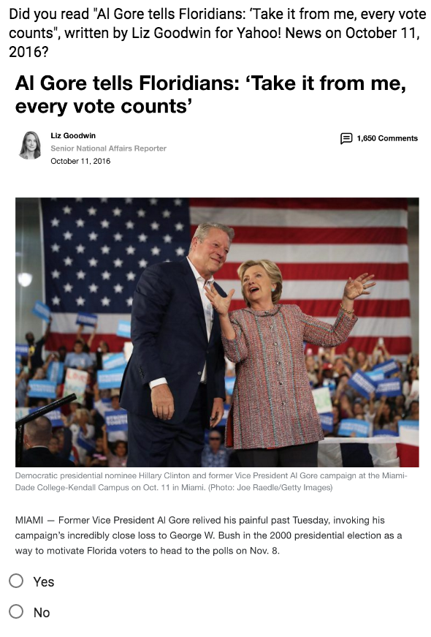
Experience Prototype 1
Give users feedback on their sources of news
Users get sources from sources other than articles
Most people have not read many articles

Slide 17
How might we…
Help people receive a more well-rounded version of the news
?
Notes:
Consistent questioning across individuals
Pros: aren’t scattered about with our questions and thus able to discern some kind of pattern
Cons: Maybe asking the same questions also reduces new insights (but that is why we asked follow-up questions)
How was the voting experience for you?
How do you decide how to vote on an issue?
How often do you see media that supports/contradicts your own opinion?
Have you ever voted on a referendum? How was that experience different?
What would you want to know about referendums beforehand?
Have you ever taken a quiz about politics that tells you which politicians/ideologies you align with most? Was it accurate/surprising/…?
How do you feel while reading something (political) that you disagree with?

Slide 18
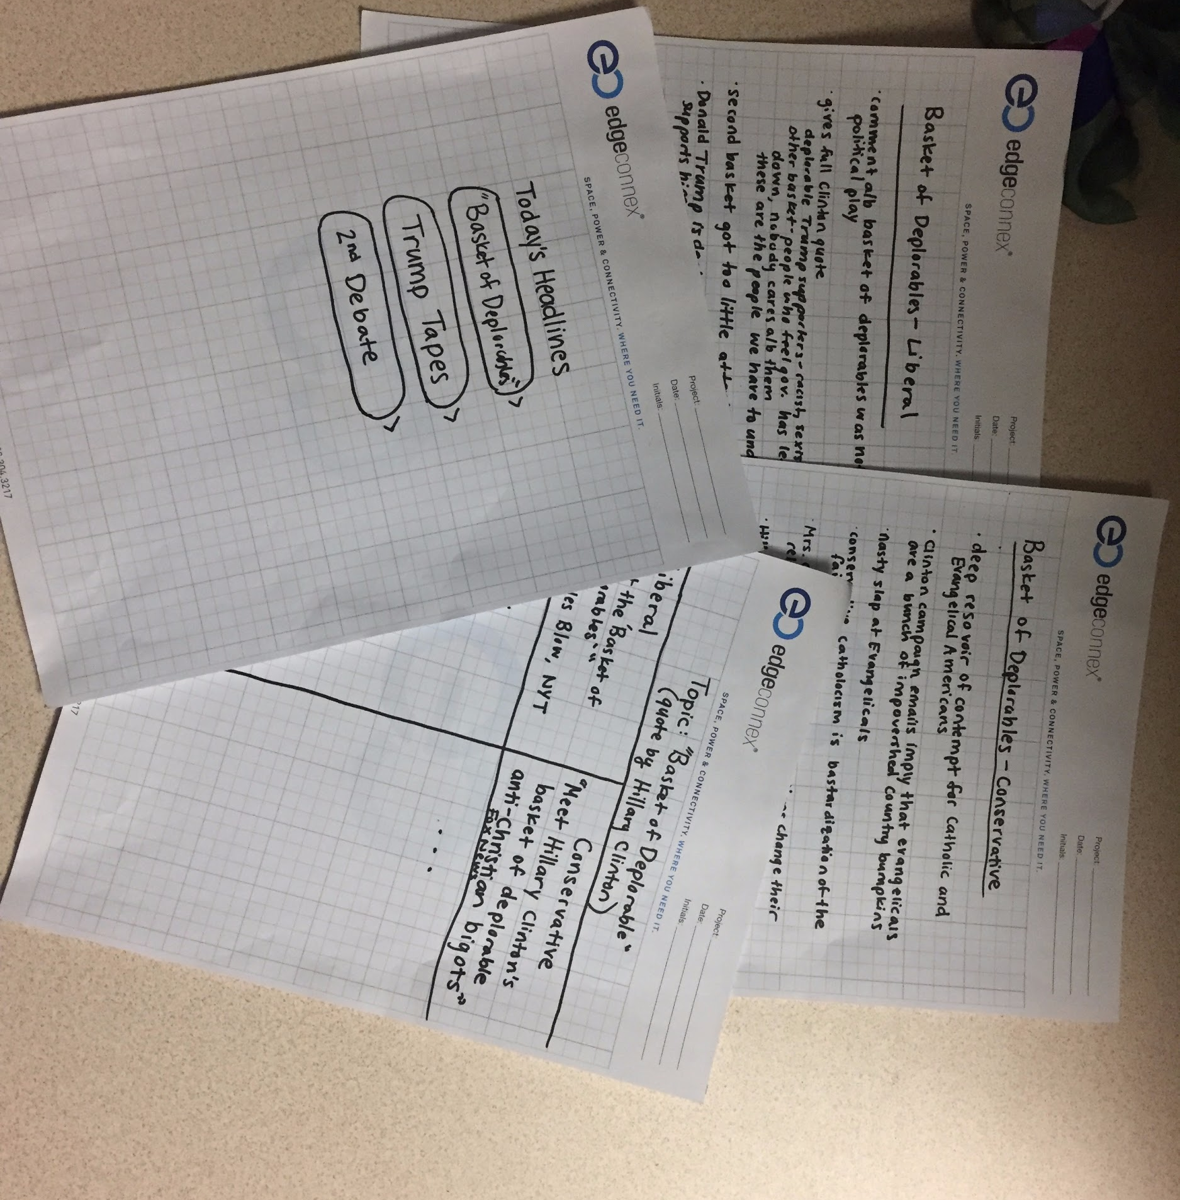
Experience Prototype 2
Users read opposing viewpoint first
“Interesting” and “enlightening” to see both articles at once
Still distrustful of opposing news source’s legitimacy
Notes:
Consistent questioning across individuals
Pros: aren’t scattered about with our questions and thus able to discern some kind of pattern
Cons: Maybe asking the same questions also reduces new insights (but that is why we asked follow-up questions)
How was the voting experience for you?
How do you decide how to vote on an issue?
How often do you see media that supports/contradicts your own opinion?
Have you ever voted on a referendum? How was that experience different?
What would you want to know about referendums beforehand?
Have you ever taken a quiz about politics that tells you which politicians/ideologies you align with most? Was it accurate/surprising/…?
How do you feel while reading something (political) that you disagree with?

Slide 19
How might we…
disincentivize people from reading one-sided news
?
Notes:
Consistent questioning across individuals
Pros: aren’t scattered about with our questions and thus able to discern some kind of pattern
Cons: Maybe asking the same questions also reduces new insights (but that is why we asked follow-up questions)
How was the voting experience for you?
How do you decide how to vote on an issue?
How often do you see media that supports/contradicts your own opinion?
Have you ever voted on a referendum? How was that experience different?
What would you want to know about referendums beforehand?
Have you ever taken a quiz about politics that tells you which politicians/ideologies you align with most? Was it accurate/surprising/…?
How do you feel while reading something (political) that you disagree with?

Slide 20
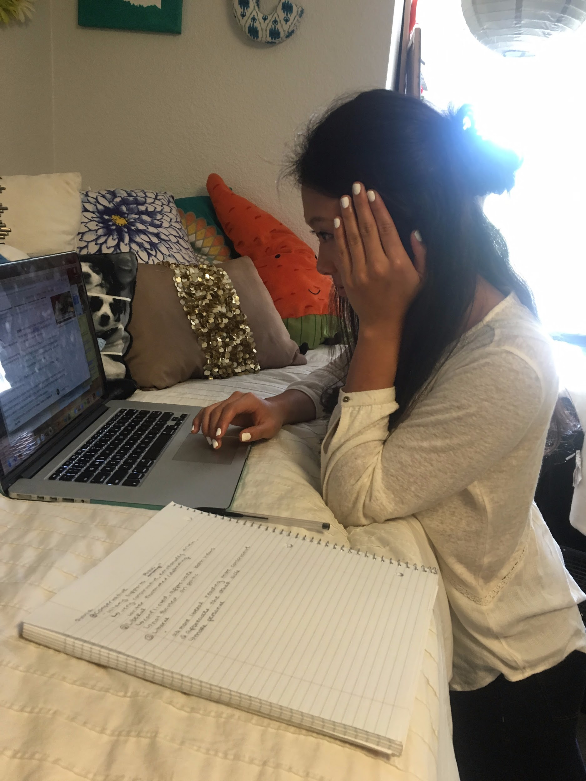
Experience Prototype 3
Naturally alternated reading articles from different sides
“Made sense” to read articles from both sides
People tend to be more open-minded if they can see that their news is one-sided

Slide 21
Key Takeaways
Difficult to classify a news source as liberal or conservative

Slide 22
Key Takeaways
Difficult to classify a news source as liberal or conservative
People tend to be more open-minded when presented with both sides

Slide 23
Key Takeaways
Difficult to classify a news source as liberal or conservative
People tend to be more open-minded when presented with both sides
In order to improve one-sided news people would have to double the amount they read

Slide 24
Appendix

Slide 25
Notes
Interview Notes
https://docs.google.com/document/d/1SDZV-Kwmp4f9Zjnz1Nx-3jqIye1yclxeO53lUIA2ZYQ/edit

